Slide 1
EU Environmental Law:
National Implementation Challenges
Áine Ryall
Oslo, 9 October 2023

Slide 2
Context and cross-cutting themes:
Impact of EU law on national systems – often very disruptive to well-established local rules and practices
Importance of access to justice to enforce EU law at national level
- Right to an effective remedy under EU law
- Article 47 EU Charter of Fundamental Rights

Slide 3
Context and cross-cutting themes:
Climate & biodiversity crisis
War in Ukraine – implications for energy security
Intense pressure on Governments to accelerate environmental
decision-making – especially for renewable energy
infrastructure
‘Push-back’ on environmental rights / access to justice

Slide 4
Characteristics of environmental law
Complexity
Scientific uncertainty
Dynamism
Precaution
Controversy*
Richard Lazarus, The Making of Environmental Law (2008)

Slide 5
Characteristics of EU environmental law
EU environmental Directives:
Often a product of political compromise
Obligations tend to be general in nature
Provisions can be open to interpretation
→ Difficult to enforce

Slide 6
A robust environmental governance architecture is essential to deliver implementation
Clear and accessible legal framework
Well-resourced public authorities
Transparency
Accountability
Access to justice to enforce environmental law

Slide 7
Why does this matter?

Slide 10
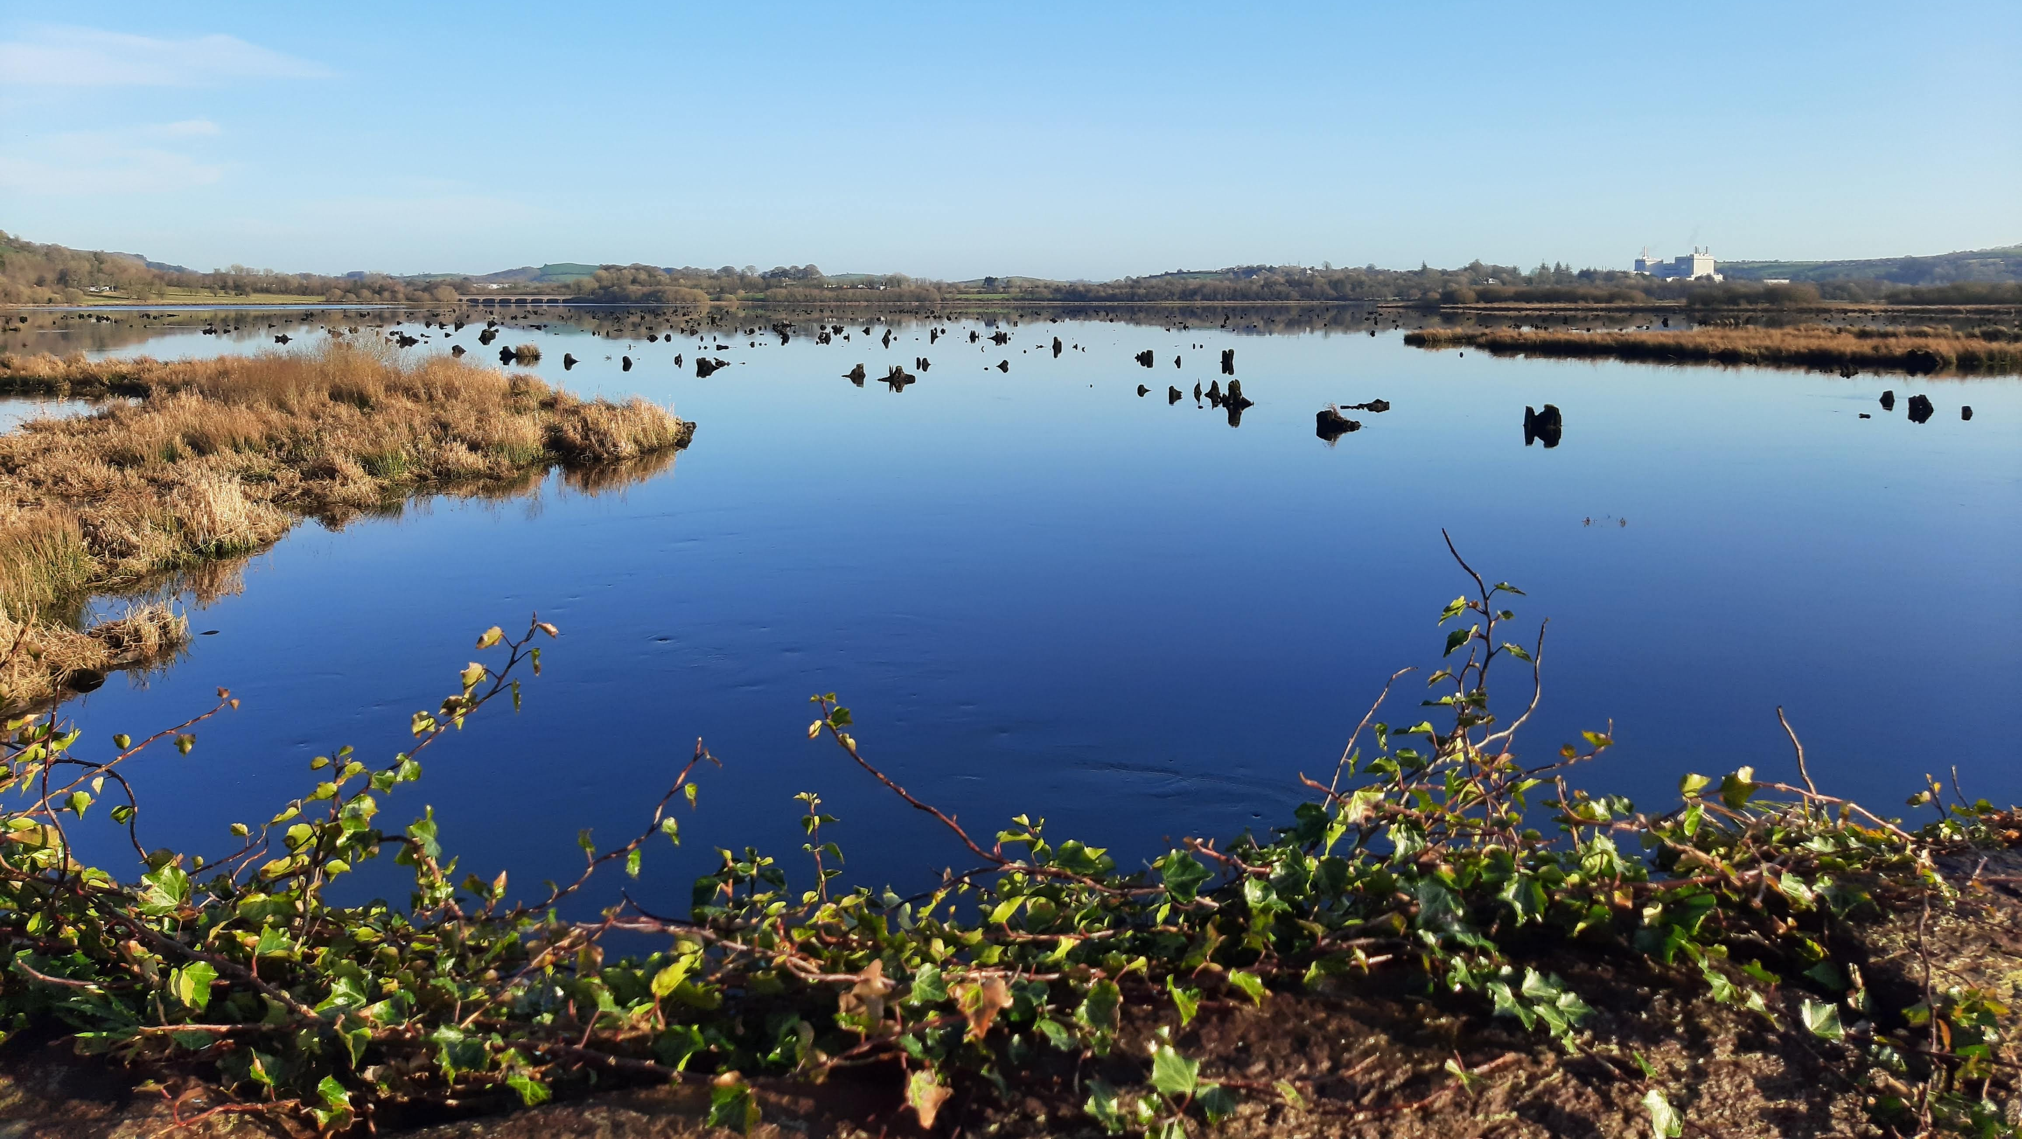

Slide 11
Key actors: role and impact
EU Commission
Court of Justice of the EU (CJEU)
National courts
National authorities
Private actors

Slide 12
Impact of International Law
on EU Environmental Law

Slide 13
United Nations Economic Commission for Europe (UN ECE): Aarhus Convention
Adopted in June 1998
Entered into force Oct 2001
Connects the environment & human rights
47 Parties including the EU and the 27 Member States

Slide 14
Aarhus Convention
Requires Parties to guarantee
three procedural
environmental rights
The right of access to justice in
environmental matters has
been a ‘game changer’ in terms of enforcement of EU environmental
law

Slide 15
Aarhus Convention
A profound impact on both EU & national environmental law
Especially as regards access to justice in environmental matters for individuals and NGOs
Significant role of CJEU in championing access to justice at national level to ensure effective judicial protection and the right to an effective remedy (Article 47 Charter)

Slide 16
National courts as EU courts & their engagement with the CJEU
Apply and enforce EU law in practice
Make a reference for a preliminary ruling to CJEU

Slide 17
Highlighting Implementation Gaps
Environmental Implementation Review (EIR)
An important reporting tool

Slide 18
Conflict and Controversy

Slide 20
Rule of (Environmental) Law?

Slide 21
Selected References
M Scholten (ed), Research Handbook on the Enforcement of EU Law
(Elgar, 2023)
M Eliantonio, E Lees & T Paloniitty (eds), EU Environmental Principles & Scientific Uncertainty before National Courts (Hart, 2023)
M Peeters and M Eliantonio (eds), Research Handbook on EU Environmental Law (Elgar, 2020)
S Kingston, V Heyvaert and A Čavoški, European Environmental Law (Cambridge University Press, 2017)

Slide 22
Selected References
S Kingston et al, ‘Europe’s nature governance revolution: harnessing the shadow of heterarchy’ (2022) 22 Int Environ Agreements 793
S Kingston et al, ‘Magnetic Law: designing environmental enforcement laws to encourage us to go further’ (2021) 15 Regulation & Governance S143-S162
S Kingston et al, ‘Empowering through Law: Environmental NGOs as Regulatory Intermediaries in EU Nature Governance’ (2023) Transnational Environmental Law
S Kingston et al, Effective Nature Laws: Executive summary for policy makers (2021)

Slide 23
Selected References
Á Ryall, ‘A Brave New World: The Aarhus Convention in Tempestuous Times’ (2023) 35 Journal of Environmental Law 161
HK Ellingsen, Standing to Enforce European Union Law before National Courts (Hart, 2021)
S Kingston, ‘A Fond Embrace: 50 Years of EU Law before the Irish Courts’ VerfBlog, 3 April 2023

