Slide 1
Enforcement of EEA law - challenges and opportunities
Melpo-Menie Joséphidès
Jurisconsult
Director Legal & Executive Affairs
EURNOR Startup Conference, University of Oslo
9 October 2023

Slide 2
ESA’s mandate
in order to ensure the proper functioning of the EEA Agreement, ESA ensures the fulfilment by the EFTA States of their EEA law obligations - Article 5 SCA
ESA as guardian of the EEA Agreement, under the supervision of the EFTA Court
ESA’s discretion, eg ESA Decision 237/22/COL

Slide 3
Enforcement: a shared responsibility
EFTA States
applying the laws
providing remedies
Role of individuals
Important role that individuals will have to play in the EEA through the exercise of the rights conferred on them … and through the judicial defence of these rights (Preamble, EEA)
European Commission (Article 109 EEA)

Slide 4
What EEA law?
E-4/22 Stendi nursing homes
E-5/21 Einarsdóttir calculation of maternity benefit
E-11/22 RS v Liechtenstein tax
Supreme Court of Norway - Boligbygg 29 September 2023

Slide 5
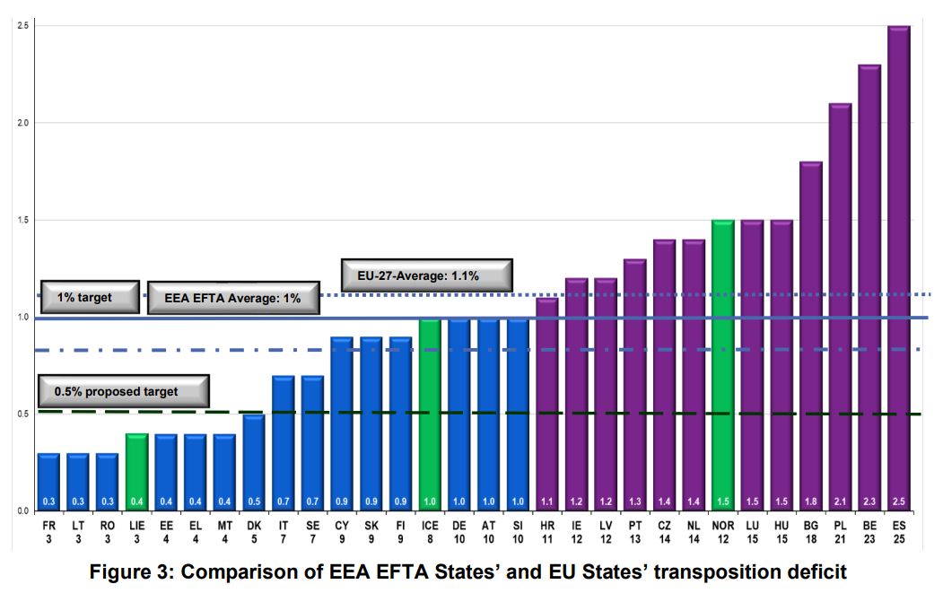
Delayed application of EEA acts

Slide 6
Awareness
Academia
Legal professions

Slide 7
Questions?

