Slide 1
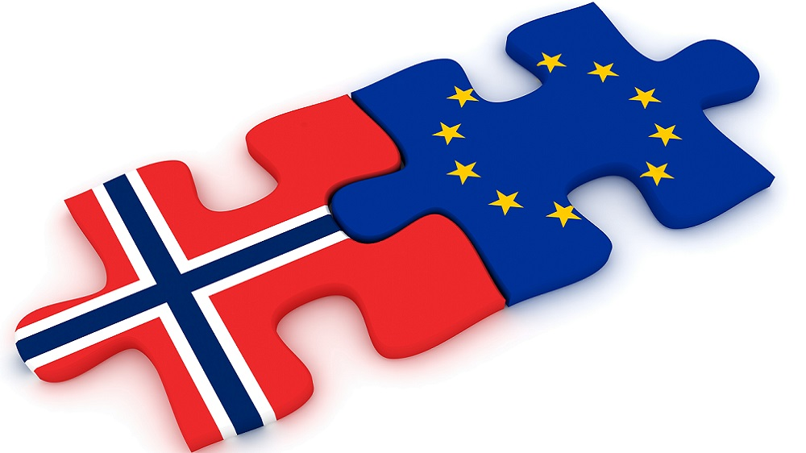
Research Centre on the European Dimension of Norwegian law – start-up conference

Slide 2
Research Centre on the European Dimension of Norwegian Law
Call by the NCR summer 2022, application deadline 21/9
42 mill NOK for two research centres dedicated to institutions holding master programs in law
Obvious background: The NAV scandal
Two applications: UiO (with UiT) og UiB (med UiS ogUiA). Both applications were granted in December 2022. Revised application by 28/2-23
UiO: Research Centre on the European Dimension of Norwegian Law
(EURNOR)
The role of/relationship to Centre for European Law, UiO (since 1989)
UiB: Centre on the Europeanisation of Norwegian Law (CENTENOL) (focusing on free movement of persons)
Notes:
Relationship CfEL: Permanent centre that was established in 1989, earlier Norwegian documentation centre for EU law, still existing as a sort of umbrella structure for European law research at UiO. Still: the EurNor centre is not identical to CfEL, involves partly other people than those associated with CfEL and the latter will exist also after the funding for the EurNor centre has run out. Have other EU/EEA law projects at UiO that belong to the CfEL umbrella structure, but not EurNor (LEVEL, ENROL).

Slide 3
Primary objective
Ensure better integration of EEA law and domestic (Norwegian) law, by improving the understanding of the complexity of the legal questions arising from the integration of EEA law in Norwegian law as well as the underlying causes for misapplication of EEA law, thereby reducing the risk of future wrongful application of EEA law
Notes:
The primary objective implies that there is a need for social science in the project, and therefore we co-operate with ARENA here. At the same time a hypothesis underlying the project is that parts of the problems stem from legal challenges inherent in the legal complexity sourrounding the EEA Agreement. Thus, the project aims to study this complexity, but at the same time also dig into the social-political reasons for misapplication of EEA law.

Slide 4
Research questions
What are the challenges of discovering the EEA dimension?
What are the challenges in interpreting and applying EEA law?
How may potential tensions between EEA law and domestic law be addressed?

Slide 5
Organization: 5 work packages (WPs)
WP1: EU law and EEA law and their interrelationship
Various features of EU/EEA law that provide challenges for correct implementation of EEA law in domestic law will be investigated
WP2: Methodological challenges to interpreting Norwegian law consistently with EEA law
Use of various legal techniques in the implementation process
Methodological variances between legal systems
WP3: Governance and rights
The legislators, courts og public administration facing the challenges
WP4: Teaching and education
WP5: Administration, coordination and dissemination

Slide 6
Fields of law subject to studies (not exhaustive)
Social security law (specifically mentioned in the call)
Labor and discrimination law
Immigration law
Environmental- and natural resources law
Energy law
Data- and AI-law
General administrative law
(Top down and bottom up)
Notes:
In the project description we have identified certain problems and challenges in different fields of law, and we want to do bottom up studies of different fields at the same time as the overarching problems will govern the studies

Slide 7
Session 1: Comparative and external perspectives on the implementation of EU law in national law
Part 1
National Implementation of EU Law: The German Experience: Professor Andreas Paulus, University of Göttingen, Germany
National Implementation of EU Law: The Danish Experience: Ass. Professor Sune Klinge, Copenhagen University, Denmark

Slide 8
Session 1: Comparative and external perspectives on the implementation of EU law in national law
Part 2
Challenges concerning national implementation of EU environmental law: Professor Aine Ryall, University College Cork, Ireland
The relationship between the European Court of Justice and national actors: Professor Daniel Naurin, University of Oslo

Slide 9
Session 2: Compliance and enforcement of EEA-law in Norway
Part 1
Melpo-Menie Joséphides, Director, Department of Legal & Executive Affairs, EFTA Surveillance Authority (ESA): Enforcement of EEA law – challenges and possibilities

Slide 10
Session 2: Compliance and enforcement of EEA-law in Norway
Part 2 (in Norwegian language)
Enforcement in practice - specific deep dives from various areas of law
The Boards of Appeal Secretariat (Klagenemndssekretariatet), by CEO Anneline Vingsgård
The Anti-Discrimination Tribunal by senior adviser Sunniva Ingermårsen
The Financial Supervisory Authority by Ann Viljugrein
The consumer field by Vebjørn Wold, Doctoral Research Fellow - Department of Private Law, University of Oslo
The National Insurance Court by Leif Erlend Johannessen, head of the court's EEA committee

Slide 11
Session 3: Teaching in EU/EEA law (in Norwegian language)
Outline for a teaching model: Professor Erling Hjelmeng, University of Oslo

