Slide 1
National implementation of EU law
Experiences from Denmark: 50 years of happiness
Sune Klinge, Ph.D., Tenure-track assistant Professor in Constitutional law, at the Faculty of Law, Centre for European and Comparative Legal Studies

Slide 2
Agenda: 50 years of happiness
Danish membership of EU with reservations (opt-outs)
Parliamentary involvement in the EU legislative process
The Danish legislative process and EU law implementation
Some practical case law examples (inspired by the NAV-scandal)
Student allowance and indexation mechanism for family benefits
The Danish regime of data retention and surveillance
Concluding thoughts

Slide 3
1. Denmark and the European integration
Denmark / Norway:
Surface area: 43,094 km2 ~ 385,200
Population: 5.86 million inhabitants (2022) ~5.37
Capital city: Copenhagen (600 million inhabitants) ~634,000
Political system: Constitutional monarchy ~same
Danish realm: Greenland and Faroe Island (not EU)
The procedure in Article 20 on how sovereignty can be transferred to an international organisation. 5/6 majority vote or referendum.
Accession to the EU: 1973 (50 years) ~EEA
Maastricht opt-out (Edinburg agreement)
Notes:
outer circles of the EU integration

Slide 4
1. The Danish opt-outs
The four Danish EU opt-outs since 1994. This means that Denmark was excluded from European cooperation on
Defense,
the euro and
Justice and Home Affairs (JHA)
The Danish opt-out on EU citizenship (is currently redundant) after Amsterdam Treaty.
Notes:
The opt-out on citizenship has become redundant after the adoption of the Amsterdam Treaty (1997) which clarified that EU citizenship is only supplementary, effectively nullifying Denmark’s opt-out.
Denmark had four derogations or “opt-outs” from EU cooperation. The Danish opt-outs stem from 1993 and were agreed amongst the at the time 12 Member States after the Danish population initially rejected the Maastricht Treaty in a referendum in 1992.

Slide 5
1. The defense opt-out – goodbye in 2022
The defense opt-out was abolished in a referendum on June 1, 2022.
Other referenda no-voters:
In 2000, a referendum was held on the Euro opt-out. It ended with a 'no' vote from 53.2%
In 2015, a referendum was held on introducing a modified opt-out. 53.1%.
Notes:
No referendum was actually necerssary – however a promise was made.

Slide 6
Justice and Home affairs opt-out
The JHA opt-out means that Denmark will not have to abide by EU laws
In a referendum in Dec. 3, 2015 Denmark could change the opt-out to an opt-in system: A case-by-case participation in the cooperation or not. No-voters 53.1%
The voting percentage was 72%, which means that the Danish legal opt-out is still in force. (=> parallel agreement on Europol) multilateral intergovernmental agreements
Notes:
concerning divorce between citizens from two countries, bankruptcy, asylum standards, and legal standards that set minimum rules in civil cases.

Slide 7
The Euro opt-out
The opt-out means that Denmark is not obliged to adopt the euro.
Denmark still has the krone as its currency and
the ability to conduct an independent monetary policy.
How about Sweden?

Slide 8
’multi-speed Europe’
Multi-speed Europe integration model with different degrees of integration, common goals are made by a group of EU countries to increase integration among themselves, with the idea that the other EU countries will eventually follow suit.
Ukraine and others? (Four-speed) Schengen
Notes:
Eight countries are currently candidates to join the EU, including Ukraine, Moldova and six Balkan nations.
last 30 years of history shows that those skeptical about the prospects of major EU reforms are always proven wrong
“1. The inner circle; 2. The EU; 3. Associate members; 4. The European Political Community [a loose association of European leaders that meet twice a year to talk]

Slide 9
2. Parliamentary involvement in the EU legislative process
Negotiating EU matters of major significance, the Government must obtain a mandate from the Danish Parliament’s European Affairs Committee
The Parliamentary control over the government’s EU policy is particularly important in Denmark, because of its long tradition of minority governments.
New rules (September 2023) Expert group in October 2021:
Parliamentary involvement in EU policy takes place much earlier (8 weeks) and more frequently. Allow more active participation in the EU’s pre-legislative work.

Slide 10
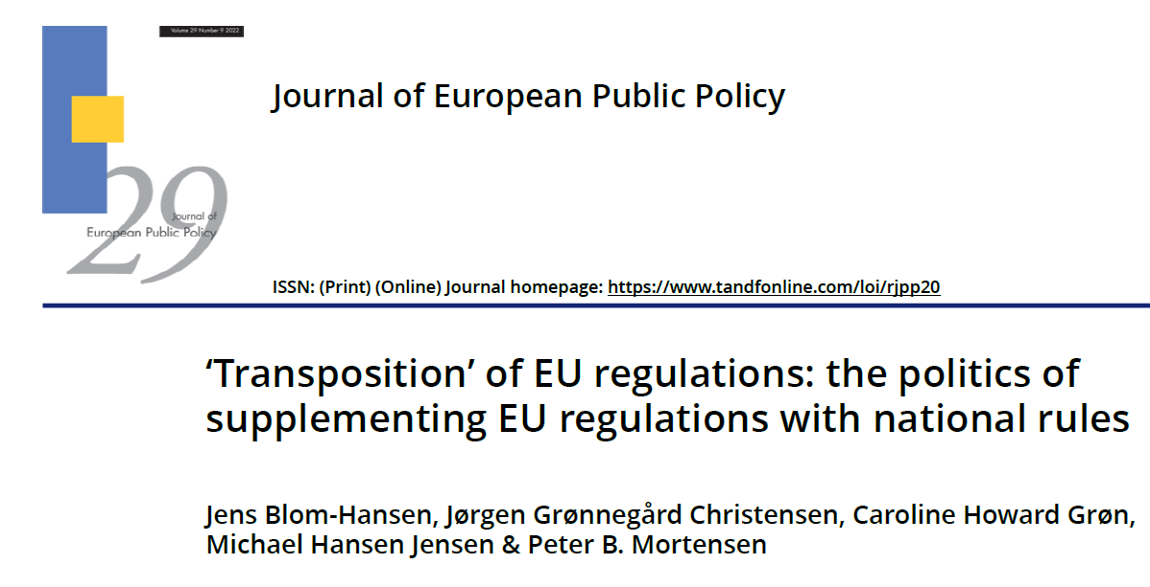
3. The Danish legislative process and EU law implementation
The EU legislation is no longer regarded as foreign policy, but are becoming more and more domestic, influencing many areas.
Focus on implementation and transposition of EU directives
New focus on EU regulations and supplementary rules
Landmark judgement in Denmark (Cabotage transportation)

Slide 11
3. The Danish legislative process and EU law implementation
Prevent gold-plating, or over-implementation (2015): new legislation implementing business-oriented EU regulation.
The five principles are:
1. As a rule, the national regulation should not go beyond the minimum requirements in EU regulation.
2. Danish companies should not be put at a disadvantage in international competition, why the implementation should not be more burdensome than the expected implementation in comparable EU countries.
3. Flexibility and exceptional possibilities in EU regulation should be exploited.
4. To the extent possible and appropriate, EU regulation should be implemented through alternatives to regulation.
5. Burdensome EU regulation should enter into force as soon as possible and taking into account the common entry into force dates.

Slide 12
3. The Danish legislative process and EU law implementation
New legislative initiatives – not coming from EU - will be analysed ex ante by the Ministry of Justice for compliance with EU law.
The preparatory work will have a chapter about compliance with EU law.
Adaptation to EU law as a result of a new development in the case law of the Court of Justice of the European Union must be explained in more detail by referring to the relevant case law.
The Danish EU Implementation Council can initiate so-called “neighbour checks”, i.e. reviews of methods used to implement EU legislation in other Member States with the aim to identify best practices.

Slide 13
4. EU law and Danish law: Examples
The Danish Students’ Grants and Loans Scheme called “SU”.
In the LN-case in which an European Union citizen who pursued an educational course in Denmark and at the same time being a ‘worker’ (free movement)
Other strategies: reduction of English-language educations
Family benefits and other tax paid subsidies: indexation mechanism as in Austria for Bulgarian and Polish workers.

Slide 14
4. Data retention and surveillance for the purpose of solving crime.
In the preparatory works: “a significant litigation risk which may materialize upon the entry into force of the new rules, in the light of paragraph 166 of the La Quadrature du Net judgment“
Generally and indiscriminately, traffic and location data. Safeguarding national security and the objective of combating serious crime.
Otherwise: targeted retention of traffic and location data. Geographical criterion. Limited in time (14 days)

Slide 15
5. Concluding thoughts: 50 years of happiness
The Danish legislator is generally in favour of the EU, but reserve the right to argue on a case-to-case basis in sensitive political areas. The public less positive (~referenda)
The mandate solution has been strengthened – more influence to the Parliament.
The courts are more reluctant to apply EU law if there has a not been a preliminary request. The doctrine to set aside national legislation is rarely used.
The executive power (the municipalities and the ministries) complying and implementing
In or out? Or in between. Denmark not in the inner circle
=>Sceptical happiness in multispeed Europe.

