Slide 1
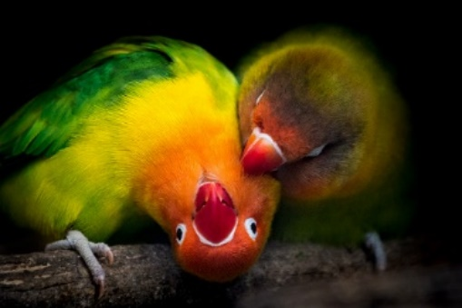
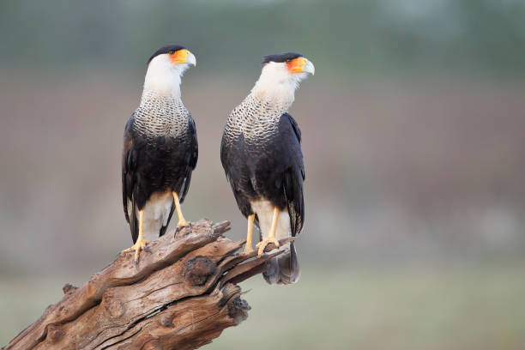
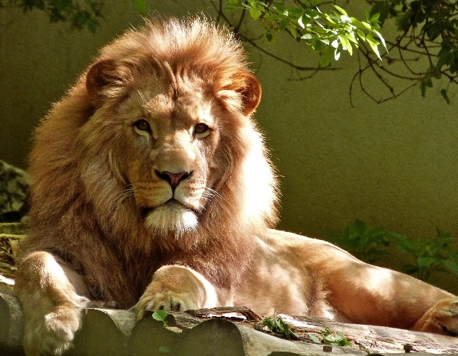
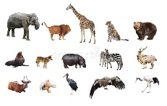
Nature Rights & Children’s Nature Rights In Environmental Governance Core Courses
A SYNOPSIS
PRESENTED BY ELIZABETH LWANDA-RUTSATE

Slide 2
PRESENTATION OUTLINE
Introduction
Course Outline on Nature’s Rights/ the Rights of Nature
Course Outline on Children’s Nature Rights.

Slide 3
INTRODUCTION
Modules formulated to be in line with the Master’s Programme’s key premise based on the three-pronged assumption that;
There is need for legal knowledge that “greens, engenders and decolonizes”
To change environmental governance at regional, national and local levels so as to promote sustainable development.
Master’s Programme situates women, children and nature at the centre of environmental governance which is critical for addressing the triple environmental crisis.
Presentation looks at the Key Modules worked on by 2 teams on;
Nature Rights in Environmental Governance
Children’s Nature Rights in Environmental Governance

Slide 4
NATURE’S RIGHTS IN ENVIRONMENTAL GOVERNANCE
CORE COURSES | ELECTIVES
1. Nature’s Rights in Environmental Governance | 1. Disaster and Risk Management, Policies & Practices 2. Biodiversity 3. Health and Environment 4. Soil (and Land)
CHILDREN’S NATURE RIGHTS
CORE COURSES | ELECTIVES
1. Children’s Rights in Environmental Governance | 1. Marine and Aquatic Environment 2. Corporate Responsibility & Environmental Governance

Slide 5
1. NATURE’S RIGHTS IN ENVIRONMENTAL GOVERNANCE
Contact Hours: 60
Purpose:
To disrupt the traditional discourses on environmental rights vis-à-vis nature
Demonstrate the interconnectedness between nature’s rights and transformative environmental governance.
To recognize nature as a subject with recognized legal capacity in access to justice > ecocentric approach
To develop strategic litigation and alternative dispute resolution techniques.

Slide 6
NATURE RIGHTS 2
Expected Learning Outcomes
By the end of this course, the students should be able to:
Critique mainstream anthropocentric/androcentric approaches to nature and environmental governance
Evaluate the existing philosophical, policy, legal and institutional foundations of nature’s rights
Assess the merits and demerits of using the ‘nature rights paradigm’ as a tool for facilitating transformative environmental governance
Apply strategic litigation and alternative dispute resolution techniques relevant to nature rights- Use strategic litigation and test cases.
Evaluate various approaches to the recognition and implementation of nature’s rights.
Critique ecological approaches on how best nature is captured as an interest and priority in environmental governance.

Slide 7
NATURE RIGHTS 3
Content:
Overview; Introduction to nature’s rights in environmental governance, Legal rights for non-humans: conceptual and philosophical foundations of nature rights; African perspectives and indigenous narratives; Policy, Legal and Institutional Frameworks-Global, Regional and Domestic; Legal implementation of the rights of nature; Rights of nature and environmental governance in practice- (case studies);
Mode of Delivery:
Lectures, Tutorials; Case studies; Seminar discussions; individual student and audio-visual, group presentations, problem- based learning.

Slide 8
NATURE RIGHTS 4
Instruction Materials and/or Equipment:
Computers; Internet; Laws; Law Reports; Discussion Aids; Chalk/white boards and necessary accompaniments; Library; DVDs; CD-ROM; Business Source Premier; E-Journals: Lexis-Nexis; HeinOnline; JSTOR.
Assessment:
Type Weighting (%)
Examination 60
Continuous Assessment 40
Total 100

Slide 9
NATURE RIGHTS 5
Core Reading Materials
Boyd David R (2017)The Rights of Nature: A Legal Revolution That Could Save the World (ECW Press)
Jens Kersten, “Who Needs Rights of Nature?” In: “Can Nature Have Rights? Legal and Political Insights,” edited by Anna Leah Tabios Hillebrecht and María Valeria Berros, RCC Perspectives: Transformations in Environment and Society 2017, no. 6, 9–13. doi.org/10.5282/rcc/8209.
Nash, Roderick Frazier (1989), The Rights of Nature, A History of Environmental Ethics, (The University of Wisconsin Press)
Sheber, Kaitlin Legal Rights for Nature: How the Idea of Recognizing Nature as a Legal Entity Can Spread and Make a Difference Globally, 26 Hastings Envt'l L.J. 147 (2020) Available at: https://repository.uchastings.edu/hastings_environmental_law_journal/vol26/iss1/8
Stone, Christopher D. Should Trees Have Standing? Law, Morality, and the Environment. Oxford: Oxford University Press, 2010.

Slide 10
2. CHILDREN’S NATURE RIGHTS IN ENVIRONMENTAL GOVERNANCE
Contact Hours: 60
Purpose:
To introduce (low level) (engage with?) the normative basis for exploring children’s environment-related rights;
To explore local, regional, and international legal and policy frameworks underpinning children’s environment-related rights against children’s lived realities;
To interrogate the relationship between children’s rights and the environment;
To examine environmental governance from a child-centred lens;
To explore children’s agency in global responses to environmental problems; the intersectional vulnerabilities among them and the impact of legal pluralism in the enforcement of children’s rights & the remedies thereof.
To introduce (low level?) child-centred and child-appropriate research methodologies.

Slide 11
CHILDREN’S NATURE RIGHTS 2
Expected Learning Outcomes
By the end of this course, the student should be able to:
Discuss local, regional, and international legal and policy frameworks underpinning children’s environment-related rights.
Interrogate the normative foundations of children’s environment-related rights against children’s lived realities.
Conceptualise and examine children’s agency in contributing to global responses to environmental problems.
Apply child-centred and child-appropriate methodologies in research evidencing advanced research competencies and skills

Slide 12
CHILDREN’S NATURE RIGHTS 3
Content:
Historical and theoretical frameworks for children’s rights;
International, regional and domestic legal, policy, institutional and administrative frameworks vis-à-vis children’s rights focusing on the interface between the formal and informal.
Principles and concepts underpinning children’s rights in environmental governance – best interests of a child, participation, child-centred approaches, vulnerability, non-discrimination, inter-sectionality and children’s rights, sustainability, inter-generational equity;
The African and international conception of children’s rights framework
Interrogation of the concepts of childhood and personhood.

Slide 13
CHILDREN’S NATURE RIGHTS 4
6. Role of legal pluralism on the protection of children’s environmental rights
7. Discussions around intersecting vulnerabilities to deconstruct knowledge on environmental governance- practical solutions to African children’s problems related to environmental challenges
8. The role of actors, norms and structures.
9. Environmental dimensions of children’s rights – air and water pollution, climate change, loss of biodiversity and access to nature, rights to a safe, clean, healthy and sustainable environment;
10. Environmental education of students and local communities
11. Implementation of children’s rights in environmental governance, enforcement and access to justice.

Slide 14
CHILDREN’S NATURE RIGHTS 5
Mode of Delivery:
Tutorials; Case method; Seminar discussions; Individual student and group presentations, Problem based learning, field researches, seminars, debate, moots
Instruction Materials and/or Equipment:
Computers; Internet; Laws; Law Reports; Discussion Aids; White boards and necessary accompaniments; Online meeting platforms; Library; DVDs; CD-ROM; Business Source Premier; E-Journals: Lexis-Nexis; Heinonline; JSTOR.
Assessment:
Type Weighting (%)
Examination 60
Continuous Assessment 40
Total 100

Slide 15
CHILDREN’S NATURE RIGHTS 6
Core Reading Materials:
Ansell Nicola, Children, Youth and Development (Taylor & Francis 2016)
Research Report on children’s rights in a changing environment
Bakker Christine, ‘Climate Change and Children’s Rights’ in Jonathan Todres and Shani M. King (eds), The Oxford Handbook of Children's Rights Law (Oxford University Press 2020).
Godfrey Samuel and Tunhuma Farai ‘The Climate Crisis: Climate Change Impacts, Trends and Vulnerabilities of Children in Sub Sahara Africa’ ( United Nations Children’s Fund Eastern and Southern Africa Regional Office 2022) Available at https://www.unicef.org/esa/media/7061/file/UNICEF-The-Climate-Crisis-2020.pdf?embed=1 accessed 30 June 2022.

Slide 16
CHILDREN’S NATURE RIGHTS 7
5. Makuch Karen, Zaman Sunya & Miriam R. Aczel, 'Tomorrow's Stewards: The Case for a Unified International Framework on the Environmental Rights of Children' (2019) 21 Health & Hum Rts J 203.
6. Rongedzayi Fambasayi & Michael Addaney, 'Cascading Impacts of Climate Change and the Rights of Children in Africa: A Reflection on the Principle of Intergenerational Equity' (2021) 21 Afr Hum Rts LJ 29.
7. Rongedzayi Fambasayi, ‘The Protection of the Environmental Rights and Interests of Children: A South African Perspective’ [2021] Stellenbosch Law Review.
8. Thoko Kaime, ‘Children’s Rights and the Environment’ in Ursula Kilkelly and Ton Liefaard (eds) International Human Rights of Children.
*NB* To include more publications from the African region

Slide 17
END

